Slide 1
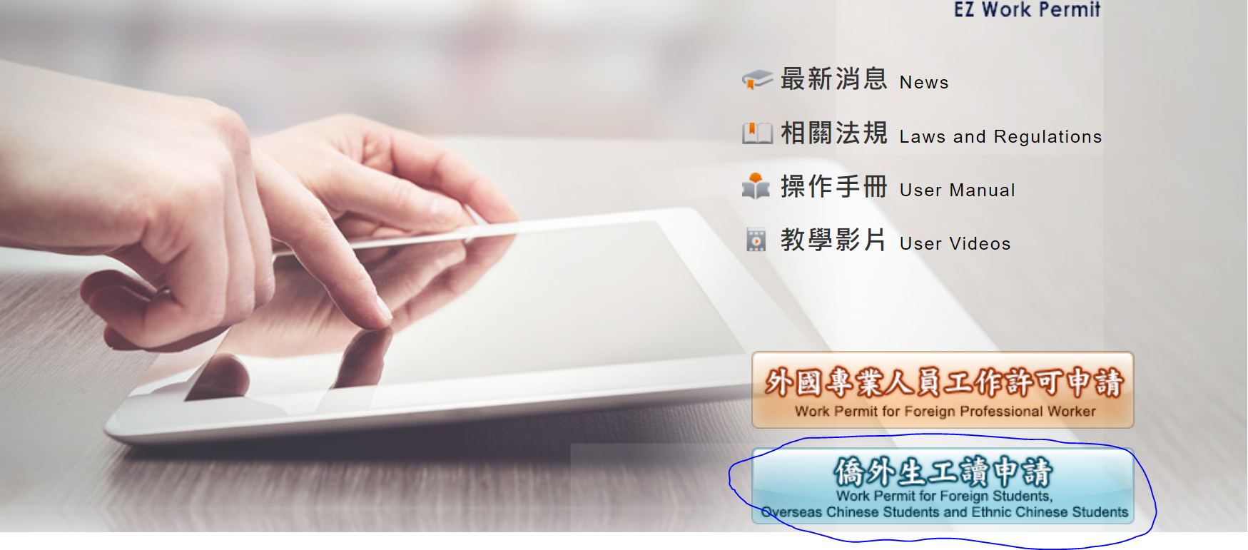
Working permit online application
Step1:
https://ezwp.wda.gov.tw/

Slide 2
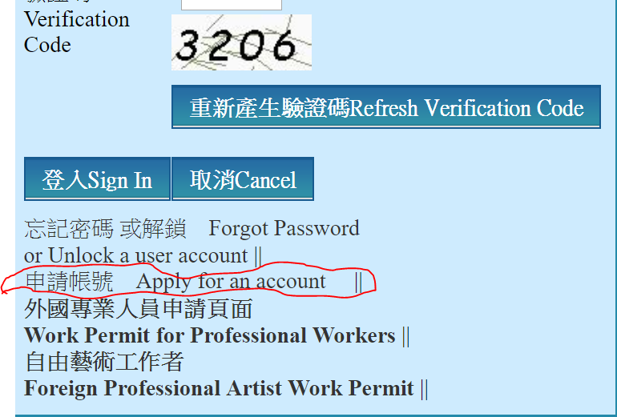
Working permit online application
Step2

Slide 3
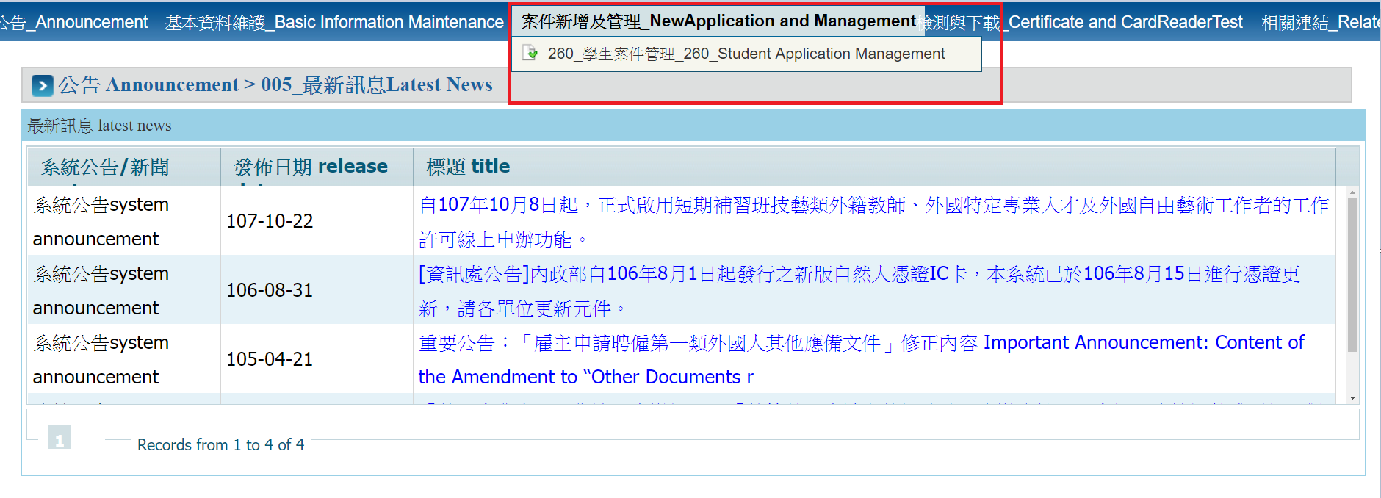
Working permit online application
Step 3 (after create an account)

Slide 4
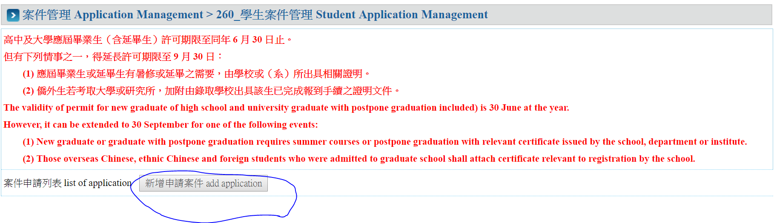
Working permit online application
Step4

Slide 5
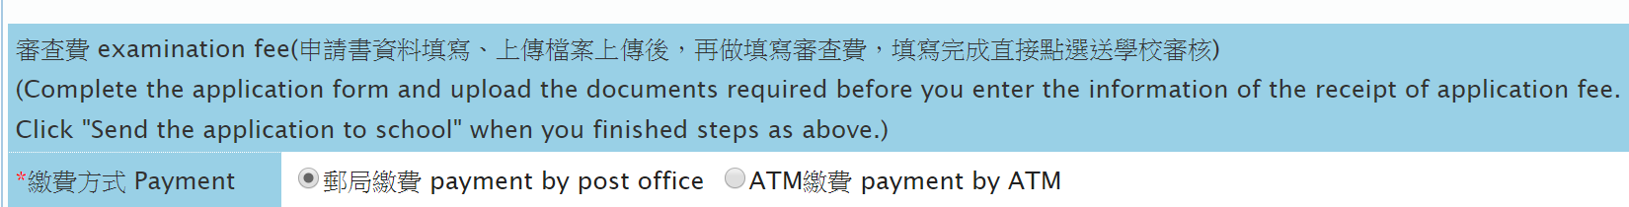
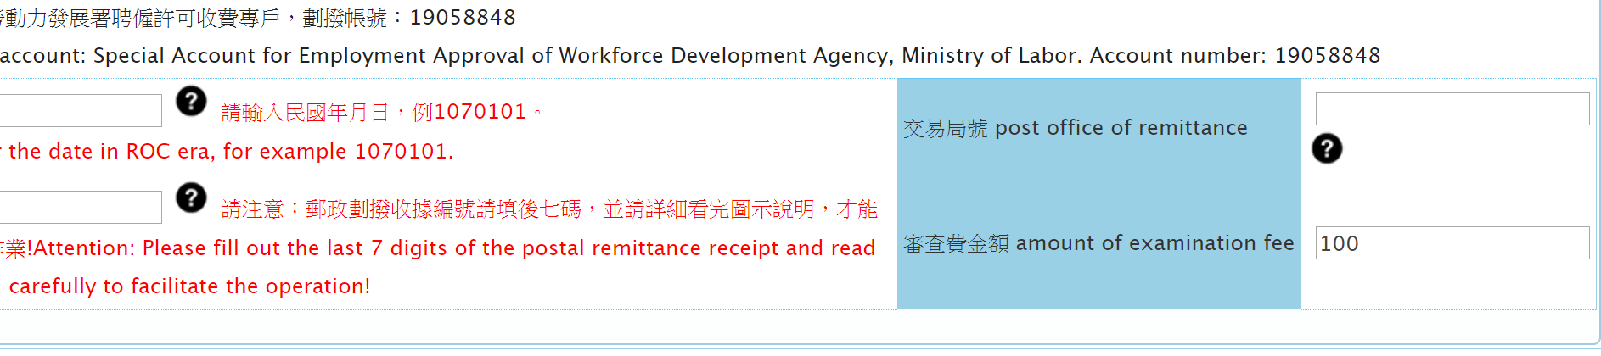
Working permit online application
Payment by post office (need to fill the column below, how to fill please press “?”)

Slide 6
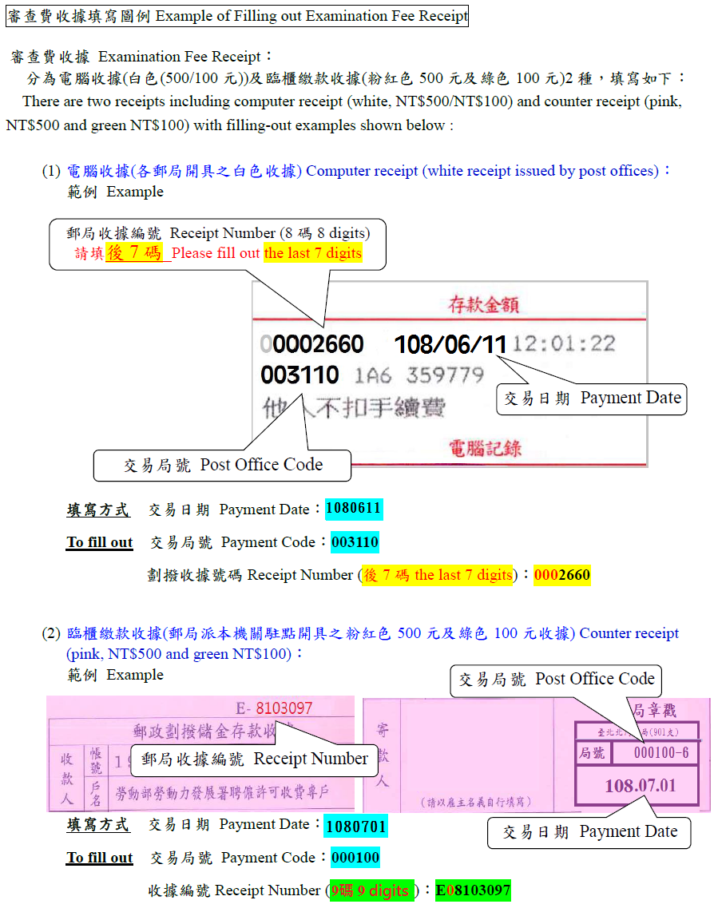

Slide 7
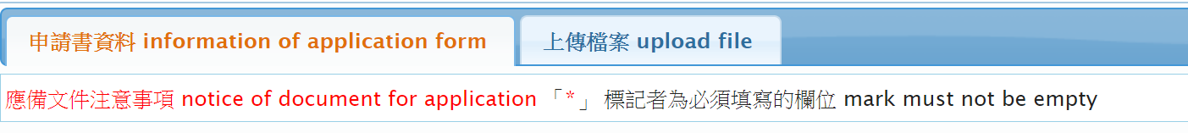
Remember to upload your passport scan！If you once extend your passport please attach the page with the new expiration date

Slide 8
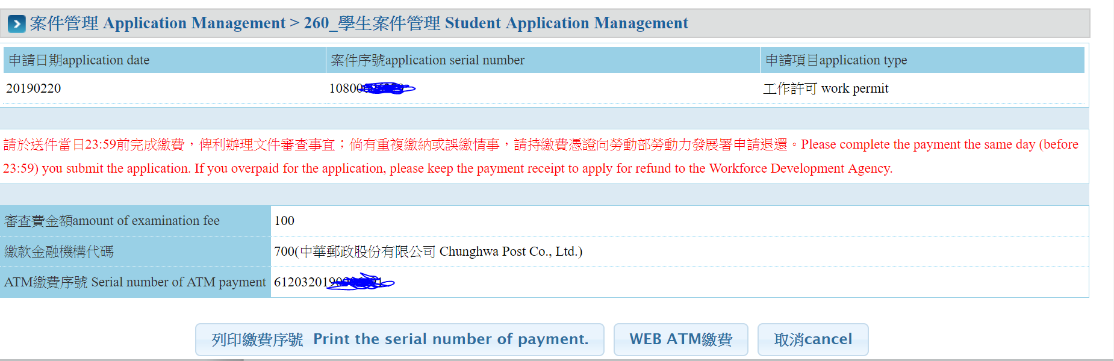
Pay by ATM: If you have local bank account and card (NOT Credit Card)
PLEASE MAKE SURE YOU UPLOAD EVERY DOCUMENTS BEFORE SEND THE APPLICATION TO SCHOOL!!!

